Slide 1
Bayesian Networks
1

Slide 2

Introduction
Suppose you are trying to determine if a patient has Covid 19. You observe the following symptoms:
The patient has a cough
The patient has a fever
The patient has difficulty breathing

Slide 3
Introduction
You would like to determine how likely the patient is infected with Covid 19 given that the patient has a cough, a fever, and difficulty breathing
We are not 100% certain that the patient has Covid because of these symptoms. We are dealing with uncertainty!

Slide 4

Introduction
Now suppose you order an x-ray and observe that the patient has a wide mediastinum.
Your belief that that the patient is infected with Covid 19 is now much higher.

Slide 5
Introduction
In the previous slides, what you observed affected your belief that the patient is infected with Covid
This is called reasoning with uncertainty
Wouldn’t it be nice if we had some methodology for reasoning with uncertainty? Well in fact, we do…

Slide 6
Bayesian Networks
Has Covid
HasCough
HasFever
HasDifficultyBreathing
HasWideMediastinum
In the opinion of many AI researchers, Bayesian networks are the most significant contribution in AI.
They are used in many applications eg. spam filtering, speech recognition, robotics, diagnostic systems and even syndromic surveillance

Slide 7
Outline
Introduction
Probability Primer
Bayesian networks

Slide 8

Probability Primer: Random Variables
A random variable is the basic element of probability
Refers to an event and there is some degree of uncertainty as to the outcome of the event
For example, the random variable A could be the event of getting a head on a coin flip

Slide 9
Boolean Random Variables
We will start with the simplest type of random variables – Boolean ones
Take the values true or false
Think of the event as occurring or not occurring
Examples (Let A be a Boolean random variable):
  A = Getting a head on a coin flip
  A = It will rain today

Slide 10
The Joint Probability Distribution
Joint probabilities can be between any number of variables
eg. P(A = true, B = true, C = true)
For each combination of variables, we need to say how probable that combination is
The probabilities of these combinations need to sum to 1
A | B | C | P(A,B,C)
false | false | false | 0.1
false | false | true | 0.2
false | true | false | 0.05
false | true | true | 0.05
true | false | false | 0.3
true | false | true | 0.1
true | true | false | 0.05
true | true | true | 0.15
Sums to 1

Slide 11
The Joint Probability Distribution
A | B | C | P(A,B,C)
false | false | false | 0.1
false | false | true | 0.2
false | true | false | 0.05
false | true | true | 0.05
true | false | false | 0.3
true | false | true | 0.1
true | true | false | 0.05
true | true | true | 0.15
Once you have the joint probability distribution, you can calculate any probability involving A, B, and C
Note: May need to use marginalization and Bayes rule, (both of which are not discussed in these slides)
Examples of things you can compute:
P(A=true) = sum of P(A,B,C) in rows with A=true
P(A=true, B = true | C=true) =
P(A = true, B = true, C = true) / P(C = true)

Slide 12
The Problem with the Joint Distribution
Lots of entries in the table to fill up!
For k Boolean random variables, you need a table of size 2^{k}
How do we use fewer numbers? Need the concept of independence
A | B | C | P(A,B,C)
false | false | false | 0.1
false | false | true | 0.2
false | true | false | 0.05
false | true | true | 0.05
true | false | false | 0.3
true | false | true | 0.1
true | true | false | 0.05
true | true | true | 0.15

Slide 13
Independence
Variables A and B are independent if any of the following hold:
P(A,B) = P(A) P(B)
P(A | B) = P(A)
P(B | A) = P(B)
This says that knowing the outcome of A does not tell me anything new about the outcome of B.

Slide 14
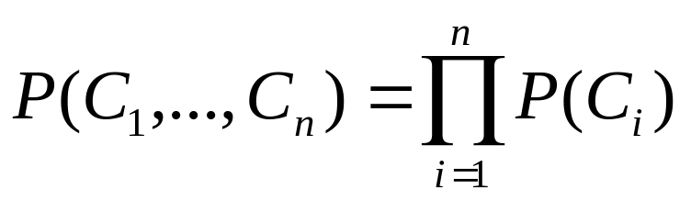
Independence
How is independence useful?
Suppose you have n coin flips and you want to calculate the joint distribution P(C₁, …, C_{n})
If the coin flips are not independent, you need 2^{n} values in the table
If the coin flips are independent, then
Each P(C_{i}) table has 2 entries and there are n of them for a total of 2n values

Slide 15
Conditional Independence
Variables A and B are conditionally independent given C if any of the following hold:
P(A, B | C) = P(A | C) P(B | C)
P(A | B, C) = P(A | C)
P(B | A, C) = P(B | C)
Knowing C tells me everything about B. I don’t gain anything by knowing A (either because A doesn’t influence B or because knowing C provides all the information knowing A would give)

Slide 16
Outline
Introduction
Probability Primer
Bayesian networks

Slide 17
A Bayesian Network
A Bayesian network is made up of:
1. A Directed Acyclic Graph
A
B
C
D
2. A set of tables for each node in the graph
A | P(A)
false | 0.6
true | 0.4
A | B | P(B|A)
false | false | 0.01
false | true | 0.99
true | false | 0.7
true | true | 0.3
B | D | P(D|B)
false | false | 0.02
false | true | 0.98
true | false | 0.05
true | true | 0.95
B | C | P(C|B)
false | false | 0.4
false | true | 0.6
true | false | 0.9
true | true | 0.1

Slide 18
A Directed Acyclic Graph
Each node in the graph is a random variable
A node X is a parent of another node Y if there is an arrow from node X to node Y eg. A is a parent of B
A
B
C
D
Informally, an arrow from node X to node Y means X has a direct influence on Y

Slide 19
A Set of Tables for Each Node
A | P(A)
false | 0.6
true | 0.4
A | B | P(B|A)
false | false | 0.01
false | true | 0.99
true | false | 0.7
true | true | 0.3
Each node X_{i} has a conditional probability distribution P(X_{i} | Parents(X_{i})) that quantifies the effect of the parents on the node
The parameters are the probabilities in these conditional probability tables (CPTs)
B | C | P(C|B)
false | false | 0.4
false | true | 0.6
true | false | 0.9
true | true | 0.1
A
B
B | D | P(D|B)
false | false | 0.02
false | true | 0.98
true | false | 0.05
true | true | 0.95
C
D

Slide 20
A Set of Tables for Each Node
Conditional Probability Distribution for C given B
B | C | P(C|B)
false | false | 0.4
false | true | 0.6
true | false | 0.9
true | true | 0.1
For a given combination of values of the parents (B in this example), the entries for P(C=true | B) and P(C=false | B) must add up to 1
eg. P(C=true | B=false) + P(C=false |B=false )=1
If you have a Boolean variable with k Boolean parents, this table has 2^{k+1} probabilities (but only 2^{k} need to be stored)

Slide 21
Bayesian Networks
Two important properties:
Encodes the conditional independence relationships between the variables in the graph structure
Is a compact representation of the joint probability distribution over the variables

Slide 22
Conditional Independence
The Markov condition: given its parents (P₁, P₂),
a node (X) is conditionally independent of its non-descendants (ND₁, ND₂)
P₁
P₂
ND₁
X
ND₂
C₁
C₂

Slide 23
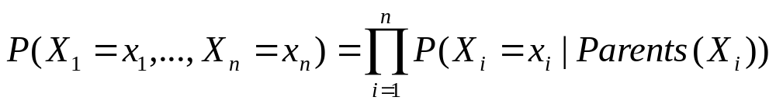
The Joint Probability Distribution
Due to the Markov condition, we can compute the joint probability distribution over all the variables X₁, …, X_{n} in the Bayesian net using the formula:
Where Parents(X_{i}) means the values of the Parents of the node X_{i} with respect to the graph

Slide 24
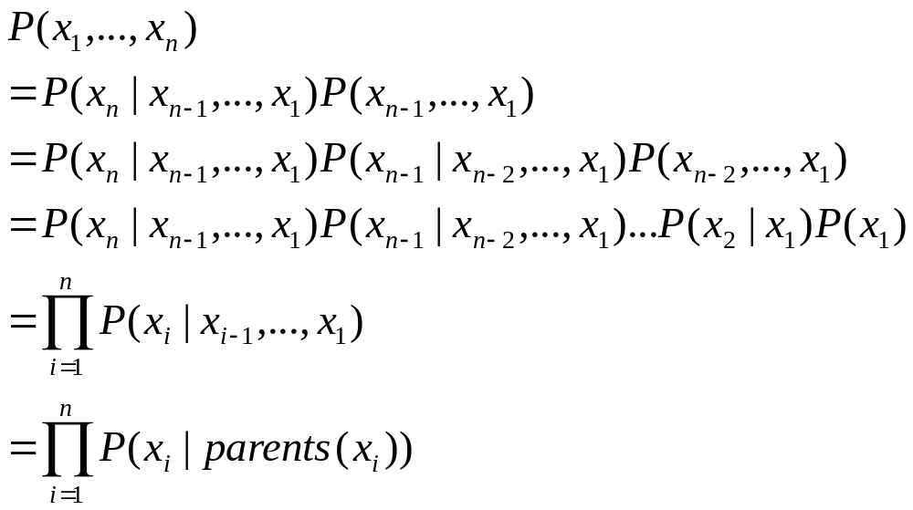
The Full Joint Distribution
( Chain Rule)
( Chain Rule)
( Chain Rule)

Slide 25
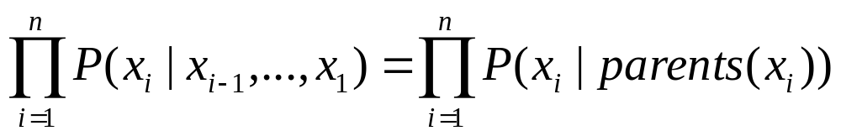
The Full Joint Distribution
To be able to do this, we need two things:
Parents(X_{i}) ⊆ {X_{i-1}, …, X₁}
This is easy – we just label the nodes according to the partial order in the graph
We need X_{i} to be conditionally independent of its predecessors given its parents
This can be done when constructing the network. Choose parents that directly influence X_{i}.

Slide 26
Example
Burglary
Earthquake
Alarm
JohnCalls
MaryCalls
P(JohnCalls, MaryCalls, Alarm, Burglary, Earthquake)
= P(JohnCalls | Alarm) P(MaryCalls | Alarm ) P(Alarm | Burglary, Earthquake ) P( Burglary ) P( Earthquake )

Slide 27
Using a Bayesian Network Example
Using the network in the example, suppose you want to calculate:
P(A = true, B = true, C = true, D = true)
= P(A = true) * P(B = true | A = true) *
P(C = true | B = true) P( D = true | B = true)
= (0.4)*(0.3)*(0.1)*(0.95)
A
B
C
D

Slide 28
Using a Bayesian Network Example
Using the network in the example, suppose you want to calculate:
P(A = true, B = true, C = true, D = true)
= P(A = true) * P(B = true | A = true) *
P(C = true | B = true) P( D = true | B = true)
= (0.4)*(0.3)*(0.1)*(0.95)
This is from the graph structure
A
B
These numbers are from the conditional probability tables
C
D

Slide 29
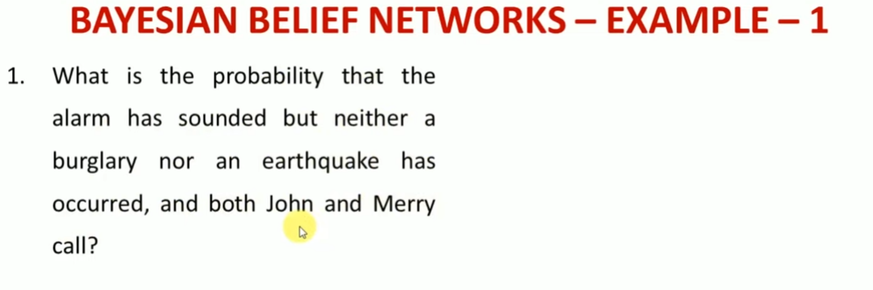
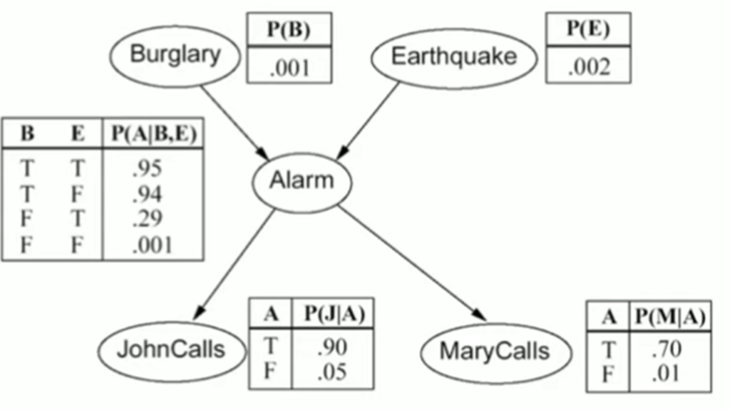

Slide 30
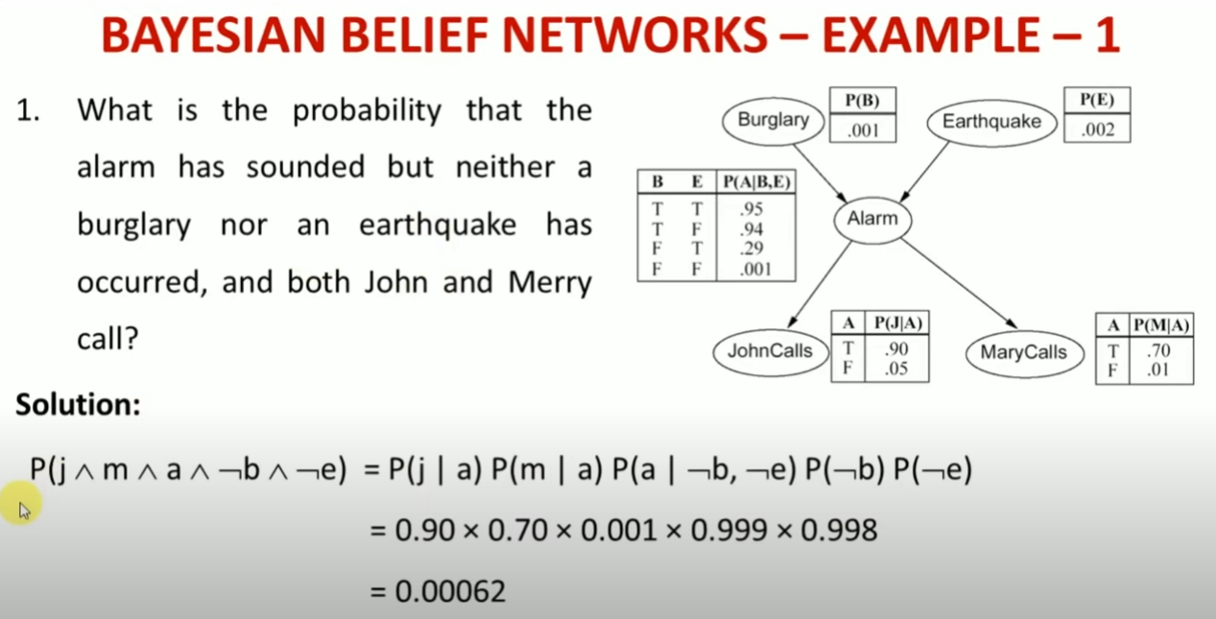

Slide 31
